Slide 1
IPL Score Predict or using Machine Learning

Slide 2


Introduction
Welcome to the world of IPL score predictions! In this presentation, we will explore the fascinating world of cricket analytics and uncover the secrets behind predicting IPL scores. Get ready to dive into the data-driven world of cricket!

Slide 3


The Power of Data
Unleash the potential of data analytics in predicting IPL scores. By analyzing historical match data, player performance, and pitch conditions, we can uncover valuable insights to forecast the outcome of IPL matches.

Slide 4


Key Factors
Understanding the impact of key factors such as batting order, bowling strategies, and weather conditions is crucial in predicting IPL scores. These factors play a signiﬁcant role in determining the ﬁnal outcome of matches.

Slide 5
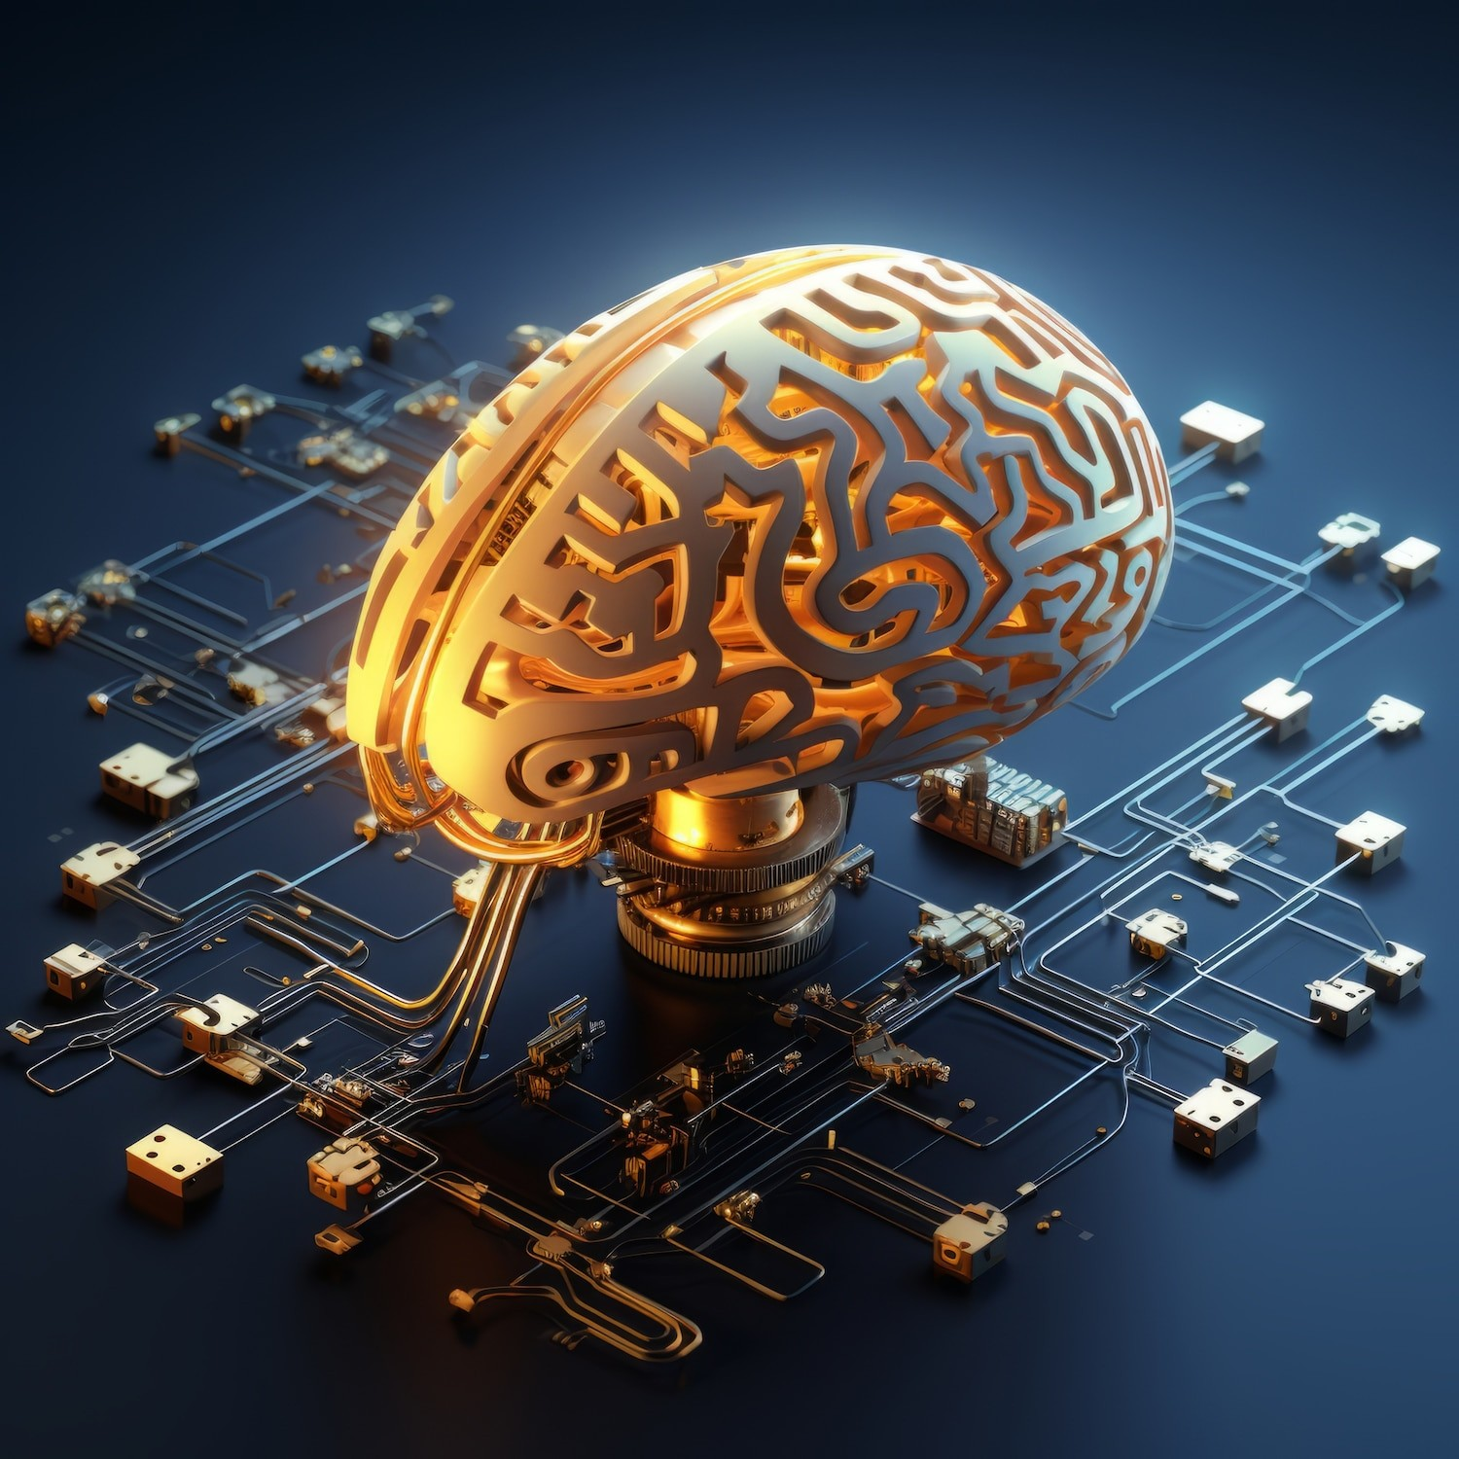

Machine Learning Models
Explore the application of machine learning models in predicting IPL scores. From regression analysis to neural networks, advanced algorithms can analyze vast amounts of data to forecast match outcomes with remarkable accuracy.

Slide 6
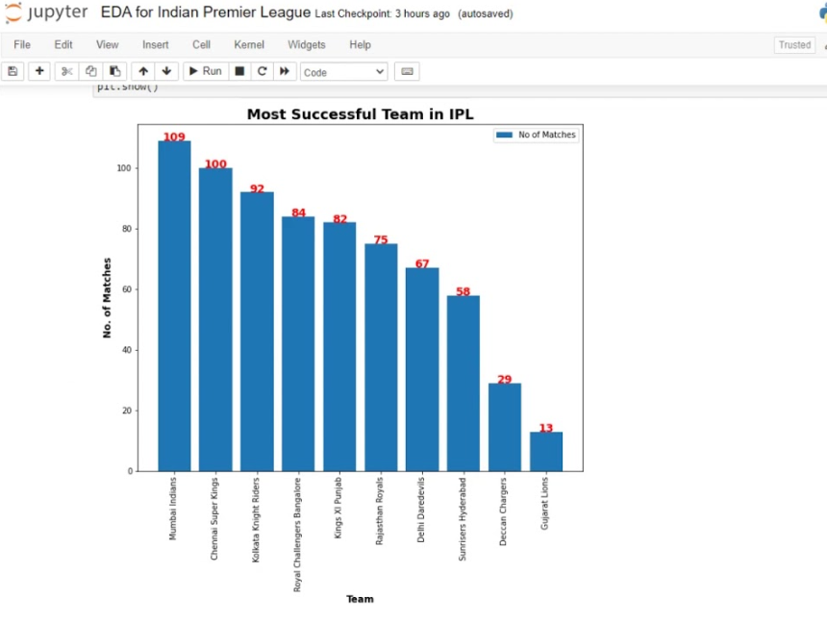
Dataset using Machine Learning

Slide 7
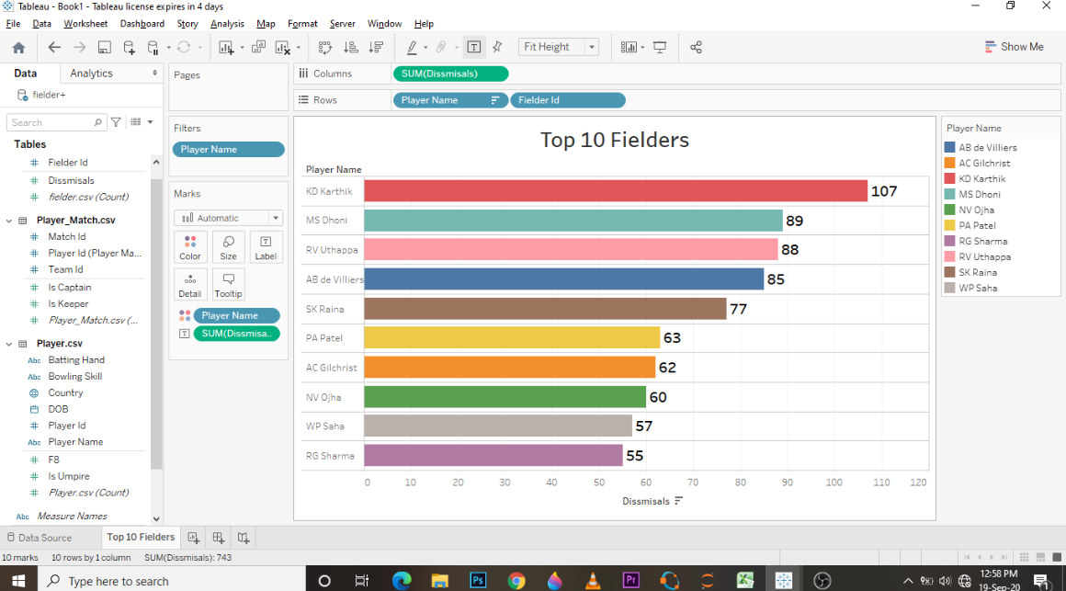
CSV FILES SNAPSHOT

Slide 8
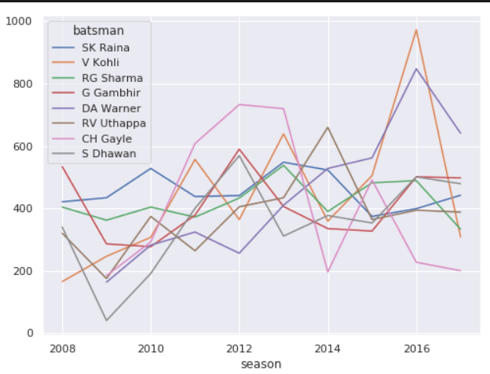
Trained Model

Slide 9


Predictive Analytics
Delve into the world of predictive analytics and its role in estimating IPL scores. By leveraging statistical techniques and historical trends, predictive models can provide valuable insights into the potential score ranges for IPL matches.

Slide 10

Real-time Data
Harness the power of real-time data to reﬁne IPL score predictions. With live updates on player performance, pitch conditions, and match dynamics, analysts can continuously adjust their predictions for enhanced accuracy.

Slide 11

Performance Evaluation
Evaluate the performance of IPL score prediction models based on historical match data. By comparing predicted scores with actual outcomes, analysts can ﬁne-tune their models and improve the accuracy of future predictions.

Slide 12

Challenges and Opportunities
Examine the challenges and opportunities in the realm of IPL score predictions. From data quality issues to evolving match dynamics, navigating these challenges presents opportunities to innovate and enhance prediction accuracy.

Slide 13


Explore the emerging trends in predicting IPL scores, including the integration of AI, enhanced data visualization, and predictive modeling advancements. The future holds exciting possibilities for elevating the accuracy of IPL score predictions.

Slide 14

Conclusion
In conclusion, the world of IPL score predictions is a captivating blend of data analytics, predictive modeling, and cricket expertise. By leveraging the power of data and technology, we can illuminate the path to more accurate and insightful IPL score predictions.

Slide 15
Thanks!

